Slide 1
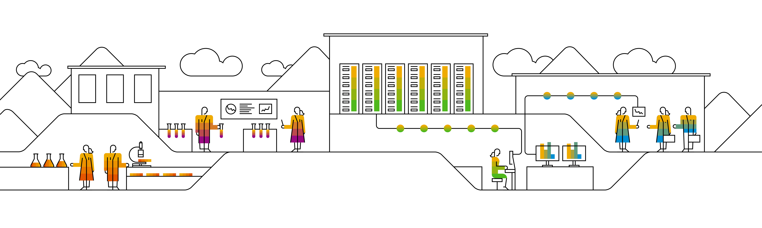
Unsupervised Learning Clustering

Slide 2
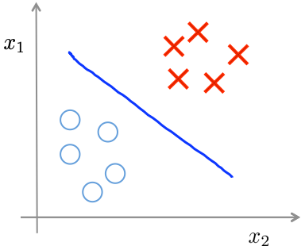
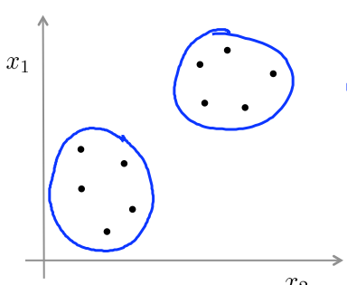
Supervised learning
Unsupervised learning

Slide 3
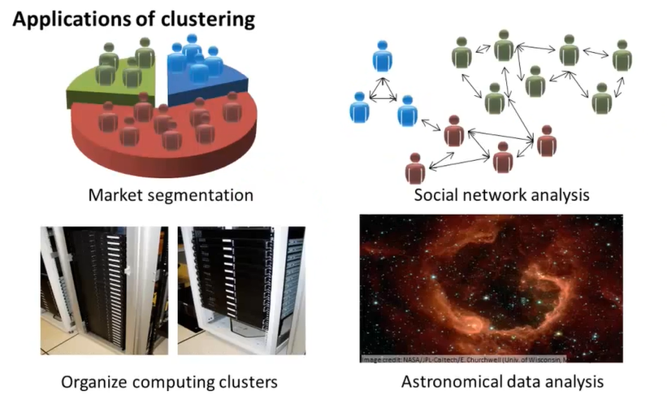
Applications of Clustering

Slide 4
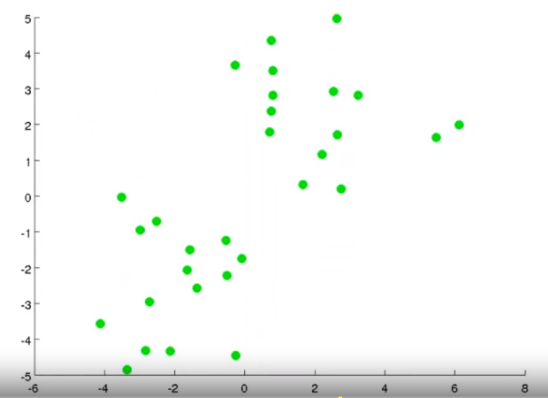
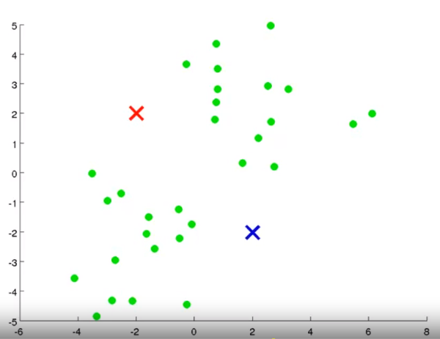
Objective Take an unlabeled dataset and group the data into clusters. Randomly assign two points, called the cluster centroids.

Slide 5
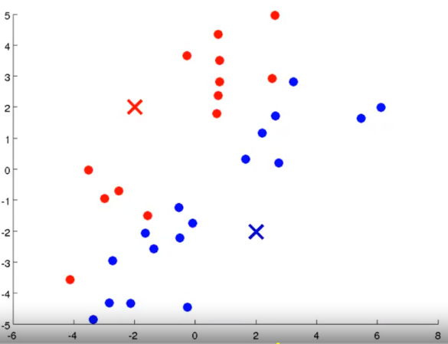
Step 1: Cluster assignment Go through the data and color each of the point either red or blue, depending on whether it is closer to the red cluster centroid or the blue cluster centroid.

Slide 6
Step 2: Move centroid Compute the mean of the red and blue points and move the respective clusters to the point.

Slide 7
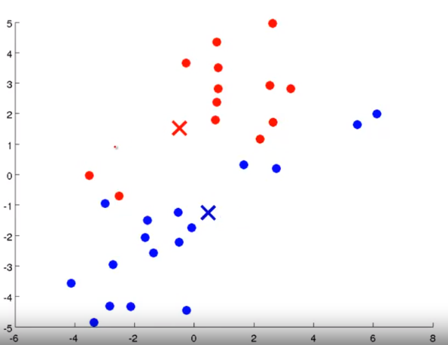
Repeat Step 1

Slide 8
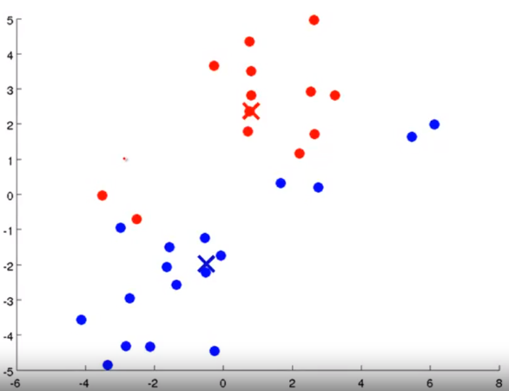
Repeat Step 2

Slide 9
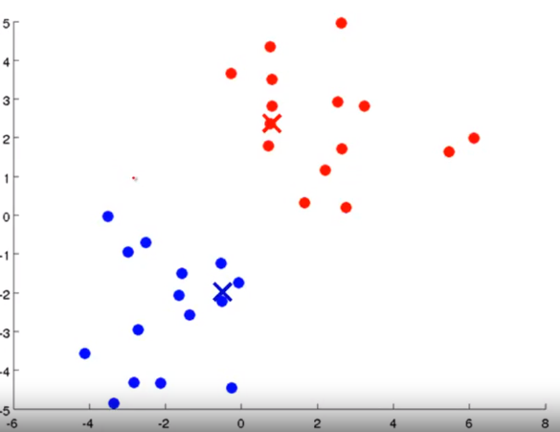
Repeat Step 1

Slide 10
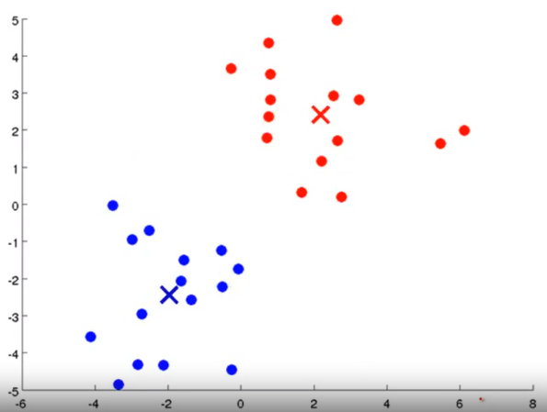
Repeat Step 2

Slide 11
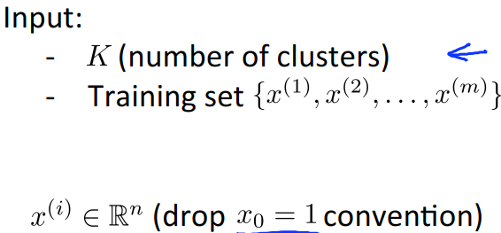

K-means algorithm

Slide 12
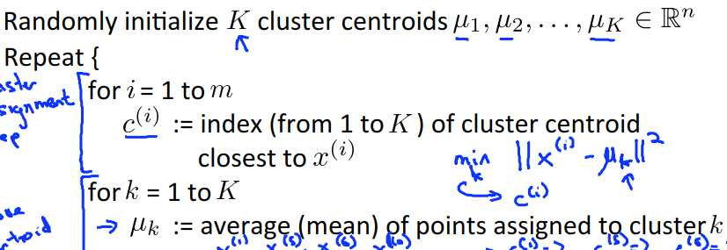





K-means algorithm
}

Slide 13
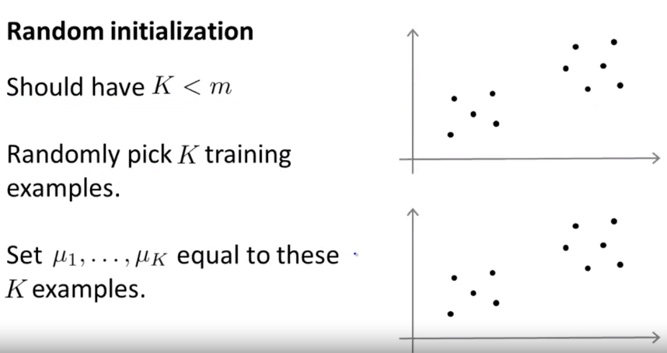
Random Initialization

Slide 14
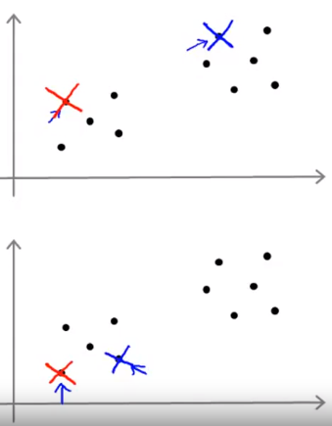
Random Initialization Example

Slide 15
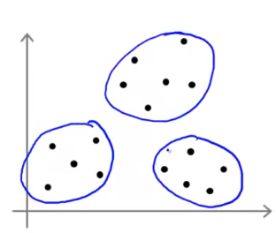
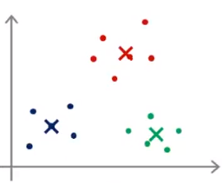
Local optima

Slide 16
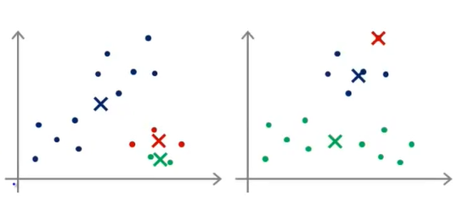

Slide 17
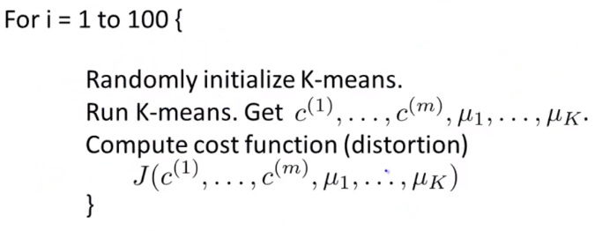
Random Initialization

Slide 18
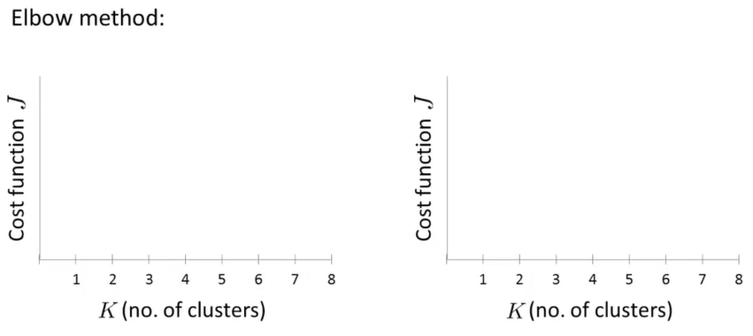
Choosing the value of K

Slide 19
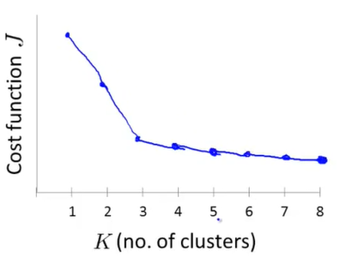
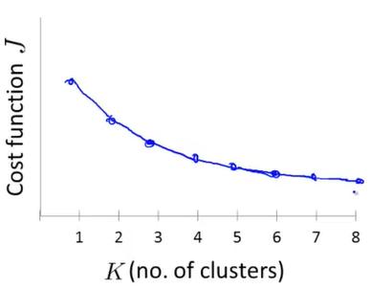

Slide 20
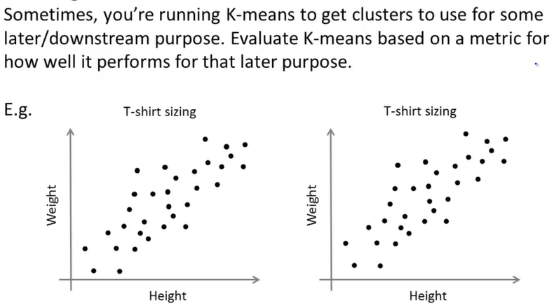
Choosing the number of K

Slide 21
Thank you.

